Slide 1

SALUS PROJECT PROGRESS

Slide 2
PROJECT ARCHITECTURE
Road cams
Accident detection model
All videos
Real time video
AWS
S3
Accident videos
Web UI
Server
Accident alerts, saved accident videos, etc.
Video/user metadata
DB

Slide 3
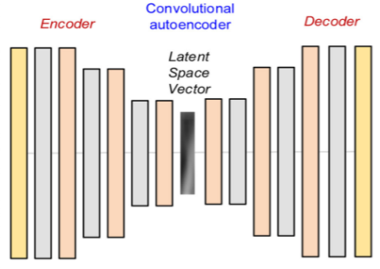
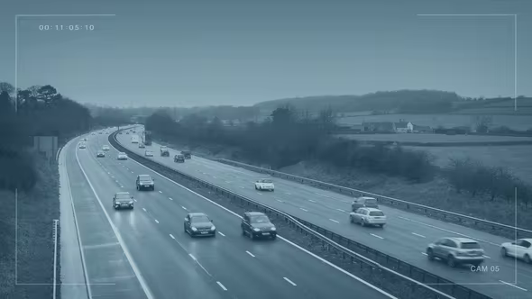
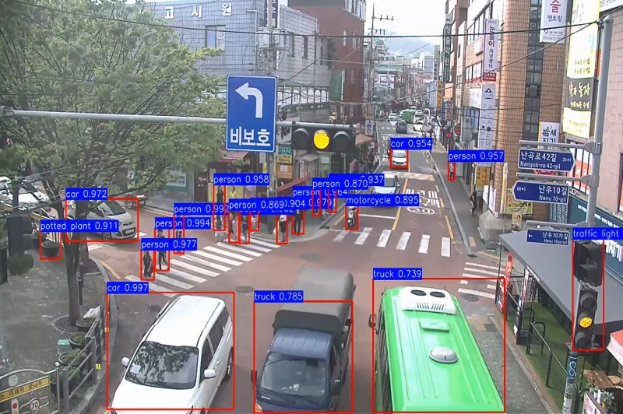
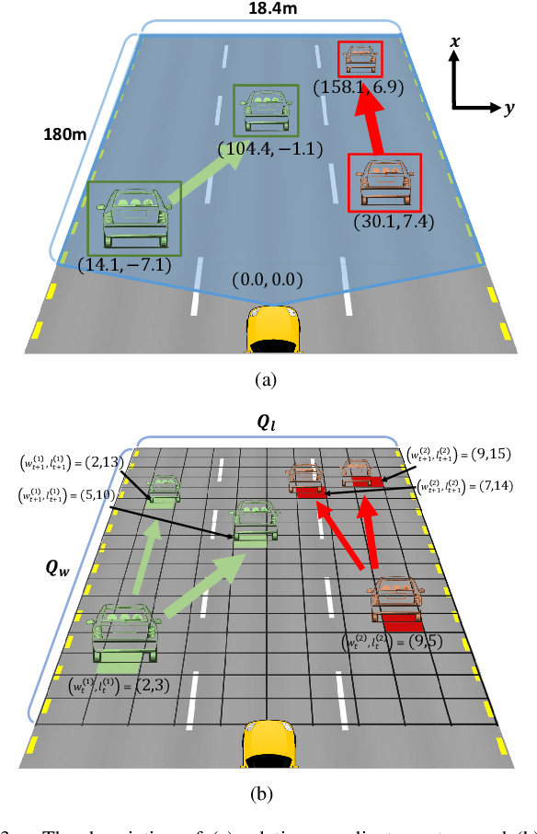
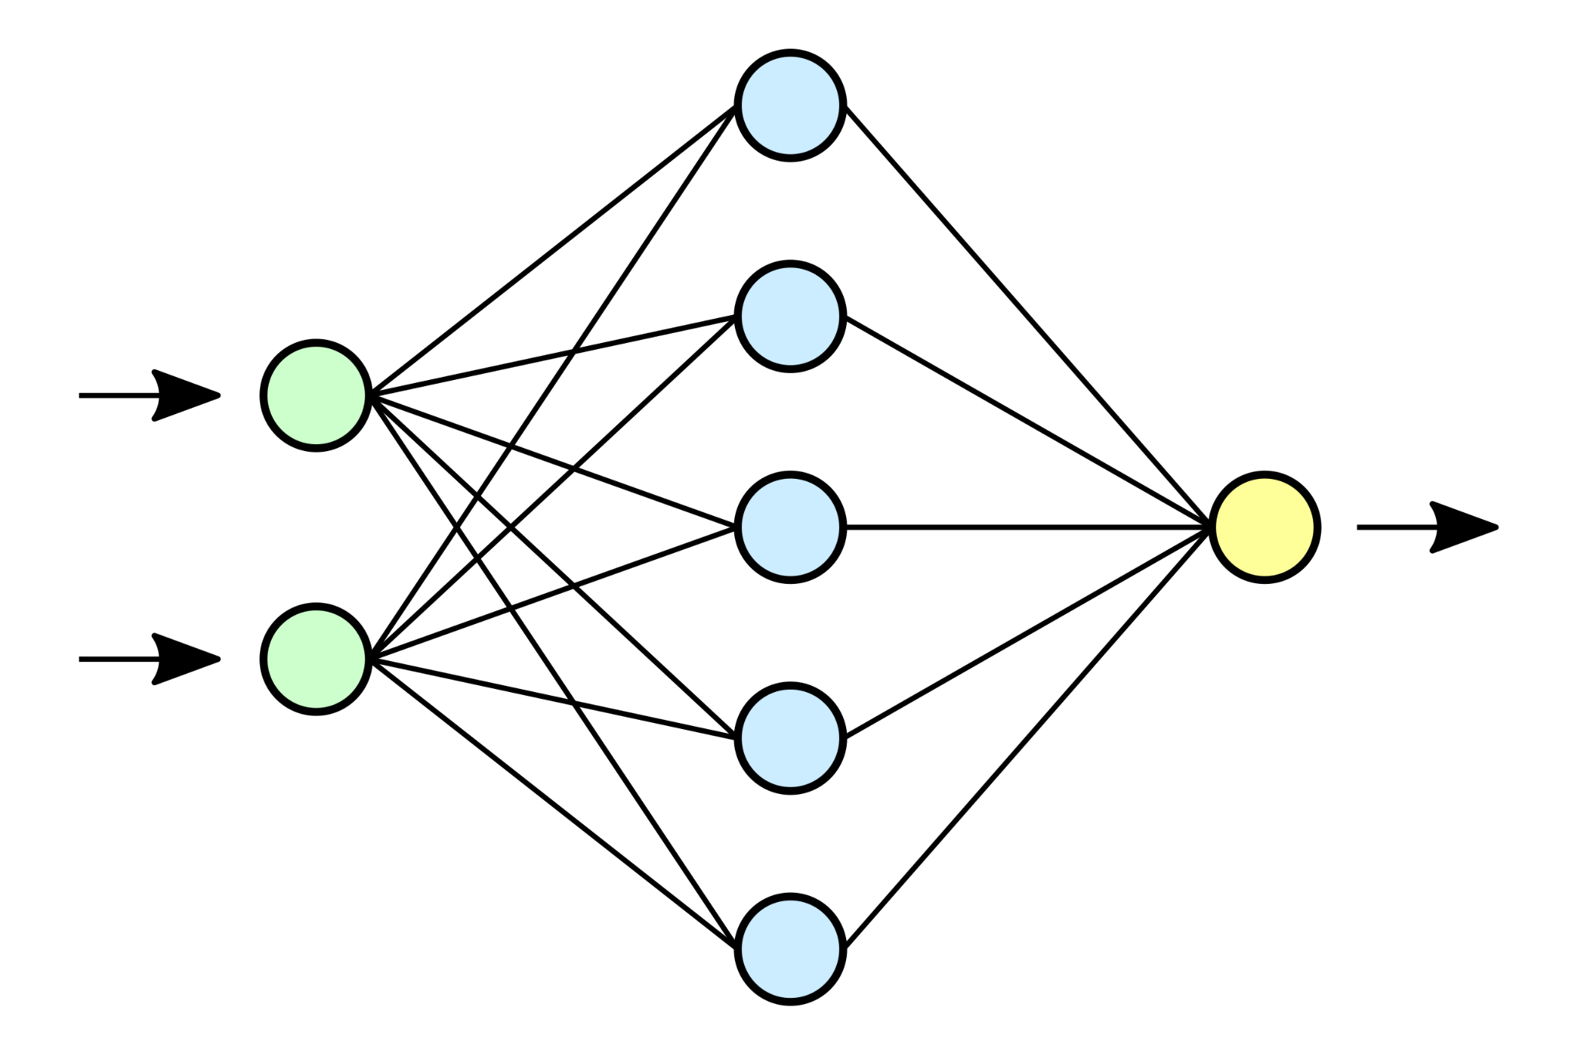
MODEL ARCHITECTURE
Short video (~5 seconds)
Extracting spatial features
using CNN model for each frame (Faster R-CNN with Inception V2 can be used)
Extracting temporal features using RNN (specifically ConvLSTM)
Fully connected
Accident probability
Classification

Slide 4
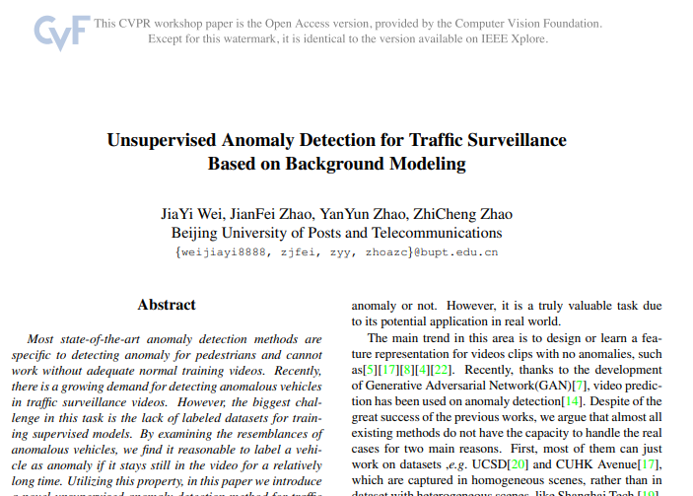
MODEL ARCHITECTURE 2
Anomaly Detection

Slide 5
MODEL ARCHITECTURE 2
Anomaly Detection

Slide 6
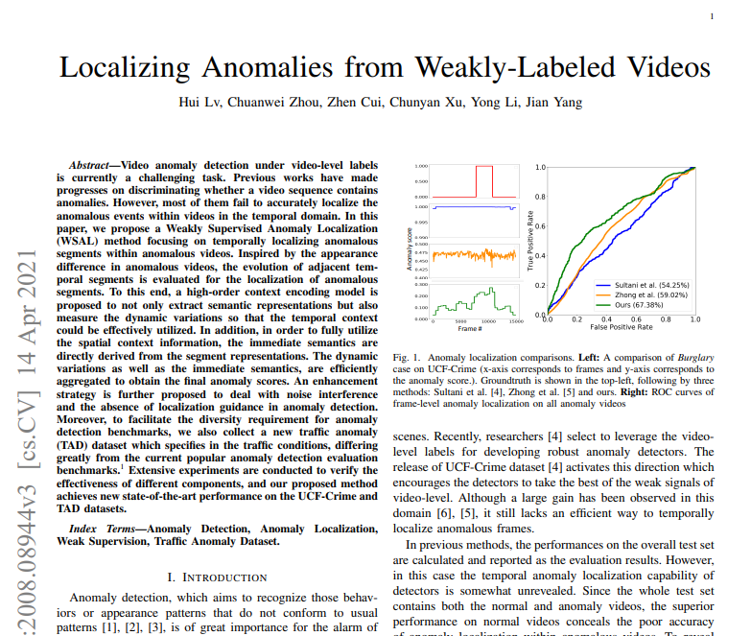
MODEL ARCHITECTURE 2
Anomaly Detection

Slide 7
OUR DATASET
https://www.loom.com/share/folder/ed23bb375dc548b282f80f4890197642

Slide 8
FEW EXAMPLES
https://drive.google.com/drive/folders/1KTac8krjinyF6old0nVJUNYTka5q2uYG

Slide 9
OUR TEAM
Vasily
Maya
Gil
Eden
Imri
Sandy

Slide 10


THANK
YOU!

